Slide 1


Surveillance System to Provide Secured Gait Signatures Using Deep Learning
Anubha Parashar ,Computer Science & Engineering, Manipal University Jaipur
Rajveer Singh Shekhawat, Computer Science & Engineering, Manipal University Jaipur
Apoorva Parashar ,Computer Science & Engineering, Maharshi Dayanand University
Vidyadhar Aski ,Computer & Communication Engineering, Manipal University Jaipur

Slide 2
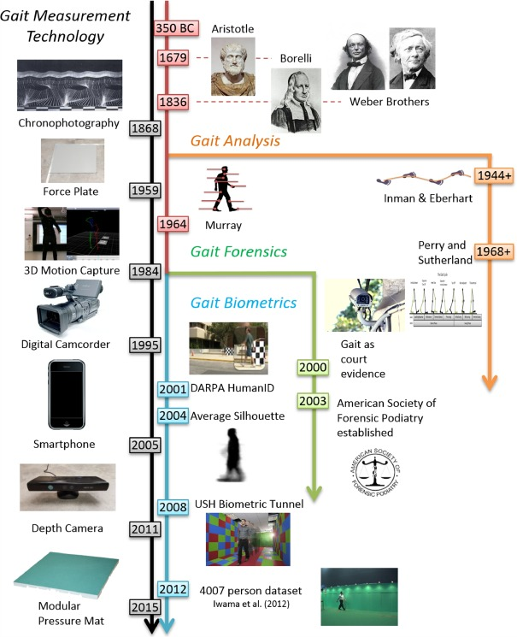
Introduction
Biometrics is an important technique for uniquely identify the human.
There are many techniques like face recognition, iris, finger print etc. But all these either need high resolution images or need human intervention.
Gait is the most efficient and effective biometric when it comes to monitoring individual subjects who are not very cooperative.

Slide 3
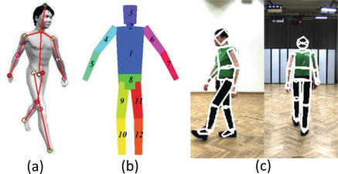
Types of Gait Recognition
Model-based methods
They have the ability to deal with the various intra-class variations caused by different covariates such as clothing, carrying and view angle which affect the subjects appearance.
However, the complexity of the models and the extraction of their components from the video stream is not a trivial task.
Consequently, model-based techniques are preferred in practical applications.

Slide 4
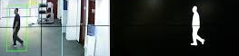
Model-free gait recognition
Model-free approaches, which can be seen as image measurement methods, exploit the moving shape of the subject to derive the gait characteristics.
Therefore, they do not require to rebuild a model of human walking steps

Slide 5
S.no | Paper | Methodology | Dataset Used | Results | Research gap | Desired Improvements
1. | Ziyuan Zhang, Luan Tran, Feng Liu, On Learning Disentangled Representations for Gait Recognition, IEEE Transactions On Pattern Analysis and Machine Intelligence,2019. | Adaptive outlier detection method to remove the effect of clothing on silhouettes. The proposed method detects the most similar parts of probe and each gallery sample independently and uses these parts to obtain a similarity measure. | Experimental results on OUISIR Gait Database, the Treadmill Dataset B and CASIA Gait Database, Dataset B | 96.44% | They have high computation cost and need considerable amount of gallery data in various conditions in order to learn the body-parts. | Take spatial and temporal features because they are invariant of all the covariate factors.
2. | Liang Wang, Tieniu Tan Silhouette Analysis-Based Gait Recognition for Human Identification Transactions On Pattern Analysis and Machine Intelligence, Vol. 25, No. 12, December 2018 | used pooled segmented statistical features to describe the shape of GEI edge contour. | CASIA B | 96.59% | Most of these methods address different covariates with limited gait views, mainly using frontal or side view of the gait sequences. In fact, it is difficult for a 2D training dataset to cover all conditions, especially incomplete gait silhouettes and with different carrying that affect the overall body shape directly | Training on all the angles so as to cover all the viewpoints.

Slide 6
S.no | Title with paper | Methodology | Dataset Used | Results | Research gap | Desired Improvements
3. | W. Kusakunniran, “Attribute-based learning for gait recognition using spatio-temporal interest points,” Image Vis. Comput., vol. 32, no. 12, pp. 1117–1126, 2014. | The gait data is firstly processed using three gait representation methods as the features sources; Accumulated Prediction Image (API) and two new gait representations namely; Accumulated Flow Image (AFI) and Edge-Masked Active Energy Image (EMAEI). | CASIA B | 91% | single view is imposed by the system setup. How can they combine (fuse) the result with normal data set with the recognition rate? Until and unless the use Sno.1 paper ie. Removing the cloth from the body. (Clothing-invariant human gait recognition using an adaptive outlier detection method) | Training on all the angles so as to cover all the viewpoints. Make a deep learning model which is best fitted for covariates such as clothing, bag pack etc.
4. | Haung, Y., Wang, L., Wang, X., & Tan, T. A Comprehensive Study on Cross-View Gait based Human Identification with Deep CNNs. Transactions On Pattern Analysis and Machine Intelligence 2017. | The main purpose of the experiments presented in this section is to provide an indication of why previous studies have achieved significantly lower recognition rates over time, by employing similar techniques to this study. The results could be improved if algorithms that are less sensitive to change in clothing are used. However, this paper does not focus on improving performance of recognition approaches but on understanding the effect of time on the performance of the baseline algorithm and a more recent gait representation. | MIT 2001 HumanoID SOTON 2002 UMD SOTON Temporal | 89% | A similar recognition performance was achieved over seven different time periods and a CCR of 95% is achieved over period of 9 months. They hypothesize that a CCR of nearly 100% could be achieved if various covariate factors (like clothing, footwear etc.) were controllable. Unfortunately, this situation is unlikely to occur in the real world. Did not take temporal features therefore less recognition rate | Taking temporal features because they are invariant of clothing.
5. | Wang, L., Tan, T., Ning, H., Hu, W.: ‘Silhouette analysis-based gait recognition for human identification’, IEEE Trans on Patt Anal and Machine Intell, 2003, 25, (12), pp. 1505–1518 2018. | show how covariates factors can separately affect the walking pattern. Further we assess the contribution and discriminatory significance of the gait dynamics used for recognition. Based on a covariate-based probe dataset of 440 samples, This is to confirm that people identification using dynamic gait features is still perceivable with better recognition rate even under the different covariate factors. | CASIA B | 83.33% and 86.67% | Used model based approach | Use model-free approach

Slide 7
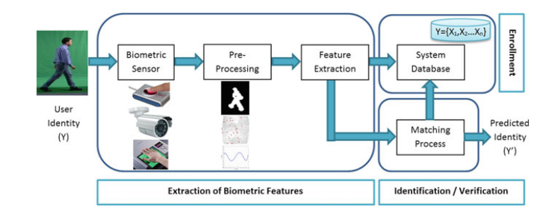
Methodology

Slide 8
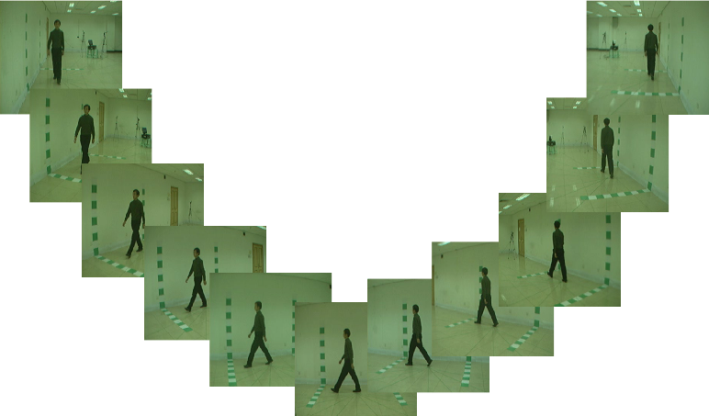
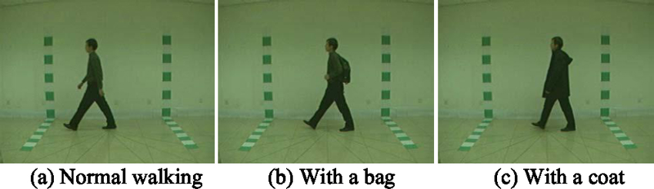
Dataset
CASIA B consist of multi-view gait database.
In this dataset there exist 124 subjects and has 11 views
In order to provide variations in covariate condition, dataset consist of three variants: clothing, view angle, and carrying bag in figure .

Slide 9
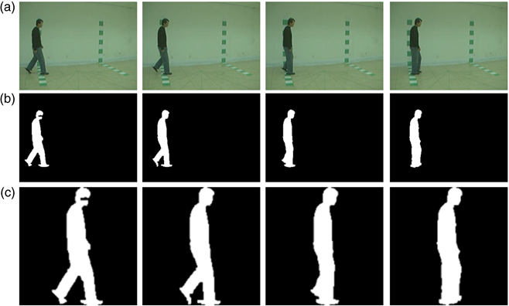
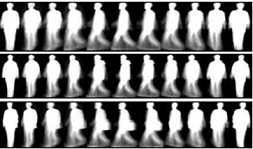
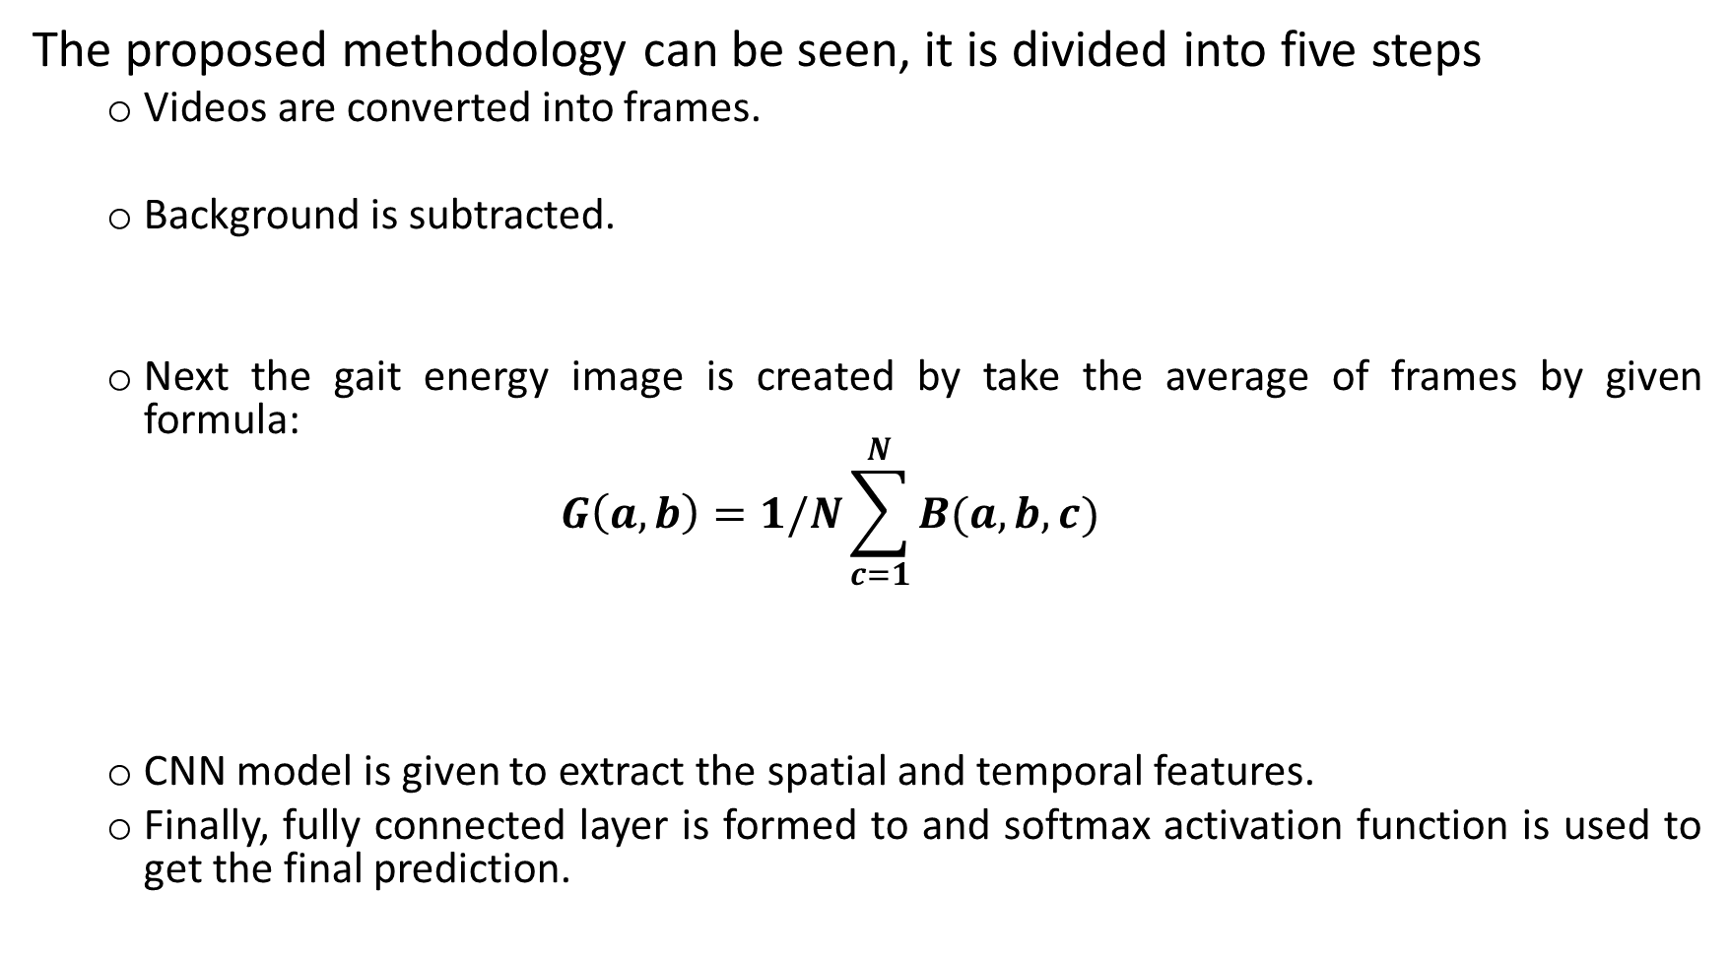
The proposed methodology can be seen, it is divided into five steps
Videos are converted into frames.
Background is subtracted.
Next the gait energy image is created by take the average of frames by given formula:
$$G\left(a,b\right)=1/N\sum_{c=1}^{N}{B(a,b,c)}$$
CNN model is given to extract the spatial and temporal features.
Finally, fully connected layer is formed to and softmax activation function is used to get the final prediction.

Slide 10
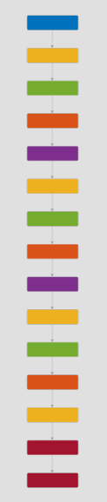
Convolution Neural Network
The network created had 15 layers consisting of:
Image Input Layer - 1
Convolution Layer - 3
Batch Normalization layer - 3
ReLU Layer - 3
Max Pooling Layer - 2
Fully connected Layer - 1
Softmax Layer - 1
Classification Layer - 1

Slide 11
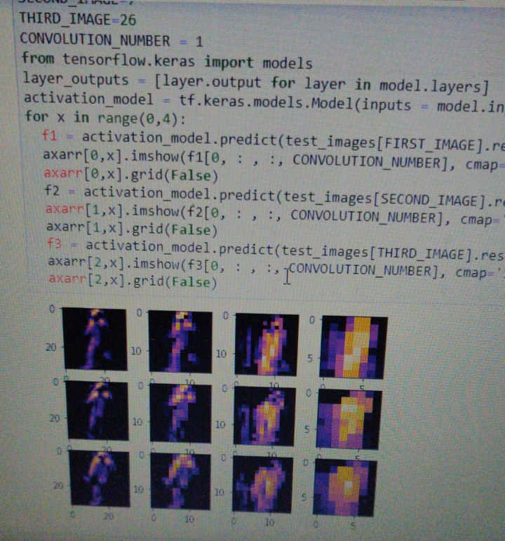

Slide 12
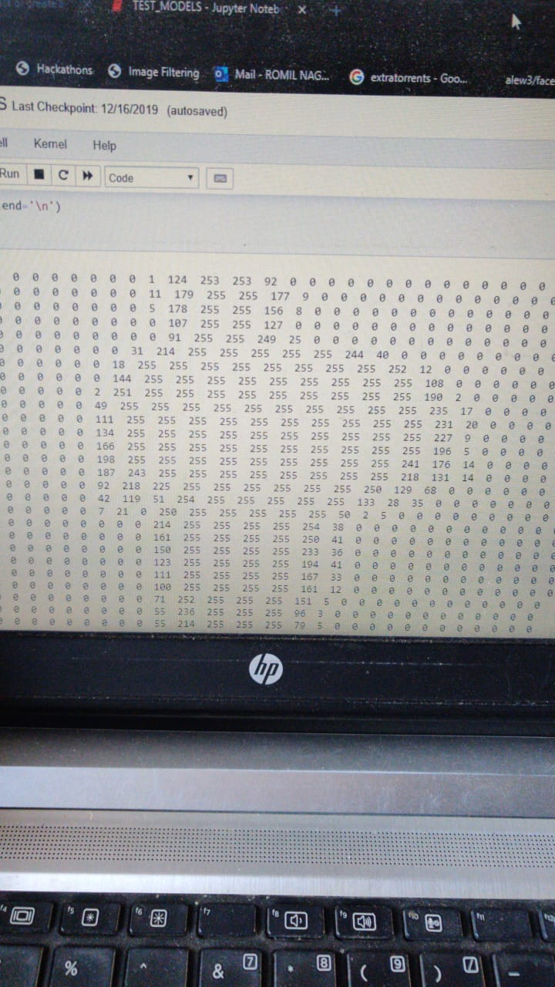

Slide 13
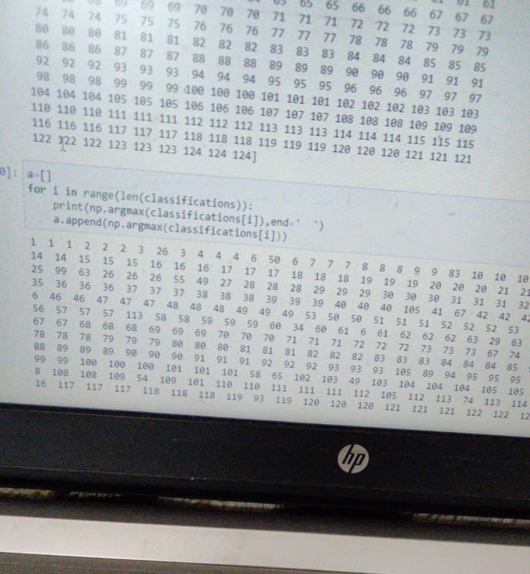

Slide 14
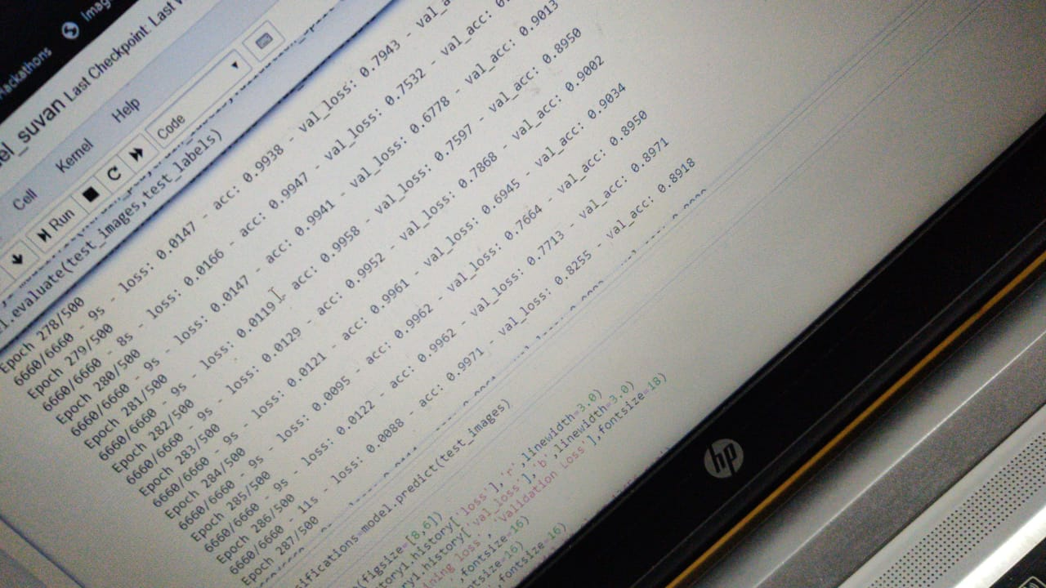

Slide 15
Results
Angle | Bag | O vercoat |  |  | N ormal
 | Our Result | Ziyuan Zhang | Liang Wang | Our Result | Deng. Et al. | Our Result
0 | 87.64 | 78.49 | 75.59 | 78.35 | 93.59 | 98.14
18 | 88.49 | 94.74 | 98.35 | 90.30 | 95.44 | 98.14
36 | 85.49 | 98.75 | 94.34 | 98.44 | 94.29 | 98.14
54 | 88.69 | 96.50 | 96.39 | 98.35 | 94.14 | 98.04
72 | 87.44 | 96.40 | 95.69 | 98.06 | 95.14 | 98.05
90 | 88.59 | 96.44 | 96.59 | 97.08 | 96.14 | 99.05
108 | 83.63 | 96.30 | 90.34 | 96.29 | 96.44 | 99.14
124 | 81.58 | 92.39 | 90.64 | 95.30 | 97.29 | 97.29
144 | 81.63 | 94.34 | 94.64 | 94.15 | 97.74 | 96.14
162 | 88.78 | 94.34 | 90.64 | 94.59 | 97.59 | 95.14
180 | 86.49 | 76.37 | 75.24 | 77.44 | 95.29 | 98.04
Recognition of human gait while carrying a bag falls under 81–90%. In overcoat clothing recognition rate is 77–100%. For normal gait is in 95–100%.

Slide 16
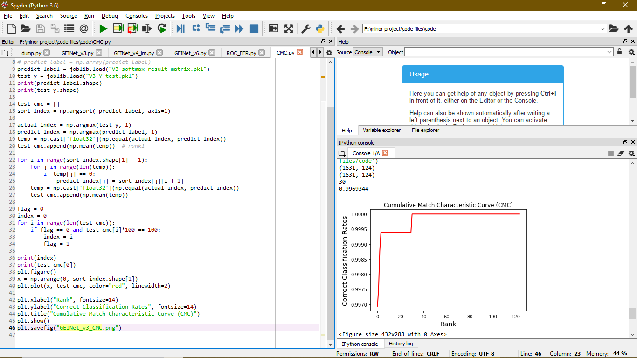
Performance

Slide 17
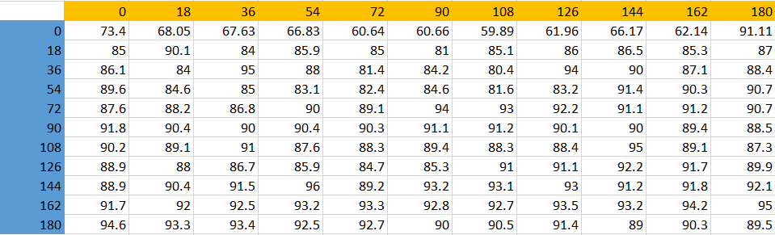
Result Analysis
When testing on two different datasets the mean accuracy is about 92.83 %

Slide 18
Result Analysis

Slide 19
Conclusion
Experimental result shows the proposed approach is more robust and efficient than previous state of art. Further, it has produced better results than the previous model-free approaches.
The major contributions of this research can be summarized as below:
Provides efficient multi variant model.
Proposed methodology gives better result than the existing methods (that is with bag, Overcoat, Normal).
As the results are good in all the angles this system can actually be used for real surveillance for providing security.

Slide 20
References
[1] Ziyuan Zhang, Luan Tran, Feng Liu, On Learning Disentangled Representations for Gait Recognition, IEEE Transactions On Pattern Analysis and Machine Intelligence,2019.
[2] Liang Wang, Tieniu Tan Silhouette Analysis-Based Gait Recognition for Human Identification Transactions On Pattern Analysis and Machine Intelligence, Vol. 25, No. 12, December 2018
[3] W. Kusakunniran, “Attribute-based learning for gait recognition using spatio-temporal interest points,” Image Vis. Comput., vol. 32, no. 12, pp. 1117–1126, 2014.
[4] Haung, Y., Wang, L., Wang, X., & Tan, T. A Comprehensive Study on Cross-View Gait based Human Identification with Deep CNNs. Transactions On Pattern Analysis and Machine Intelligence 2017.
[5] Wang, L., Tan, T., Ning, H., Hu, W.: ‘Silhouette analysis-based gait recognition for human identification’, IEEE Trans on Patt Anal and Machine Intell, 2003, 25, (12), pp. 1505–1518 2018.

